Slide 1
MTA Terror Prevention
Data Science Applied to Law Enforcement

Slide 2

Notes:
- US Department of Homeland security has emailed MTA and NYPD about potential security threat. - Audit has found current methods to be insufficient
Talk about need for data-driven solution
NYPD has hired us to solve the problem

Slide 3
Background
MTA daily ridership: 5.2 Million
Annual downtown traffic: ~110 Million
4,000 Transit incidents in 2017

Slide 4

MTA Terror Prevention
Data Science Applied to Law Enforcement
Notes:
- NYPD Has only 40,000 uniformed officers
- 4,000 Transit officers

Slide 5
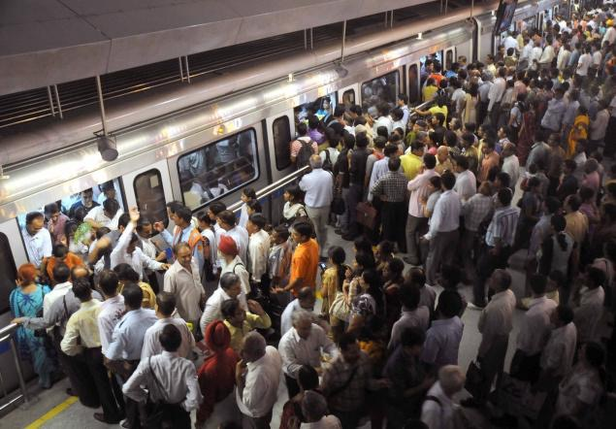
Notes:
- The amount of people on the metro fluctuates wildly over time
- Need to use resources wisely

Slide 6
The Data
MTA Turnstile Data
Extrapolating Trends
Inefficiencies
Notes:
- How was the data acquired?
- We used 3 months of data originally
- Why did we choose the amount we chose?

Slide 7
Cleaning the Data
Negative Data Points
Significant Outliers
Data Interpolation
Notes:
- Used absolute value to remove negative values
- Used 100,000 as cutoff for outliers
- Why use an arbitrary number to determine outliers?
- bfill and ffill to interpolate
- 2% of the raw data was cleaned

Slide 8
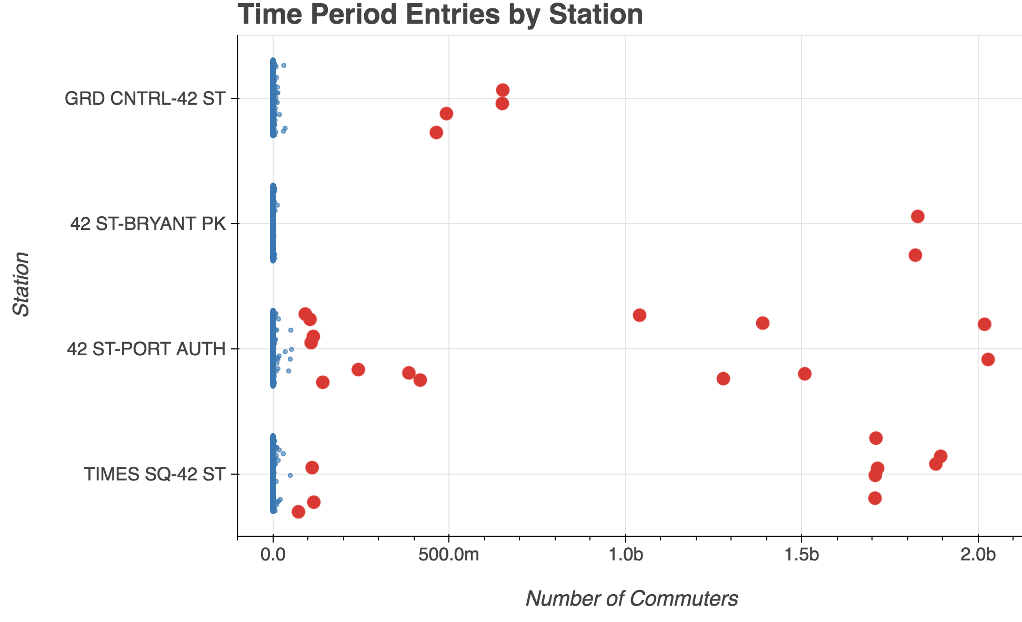
Visualizing Outliers

Slide 9
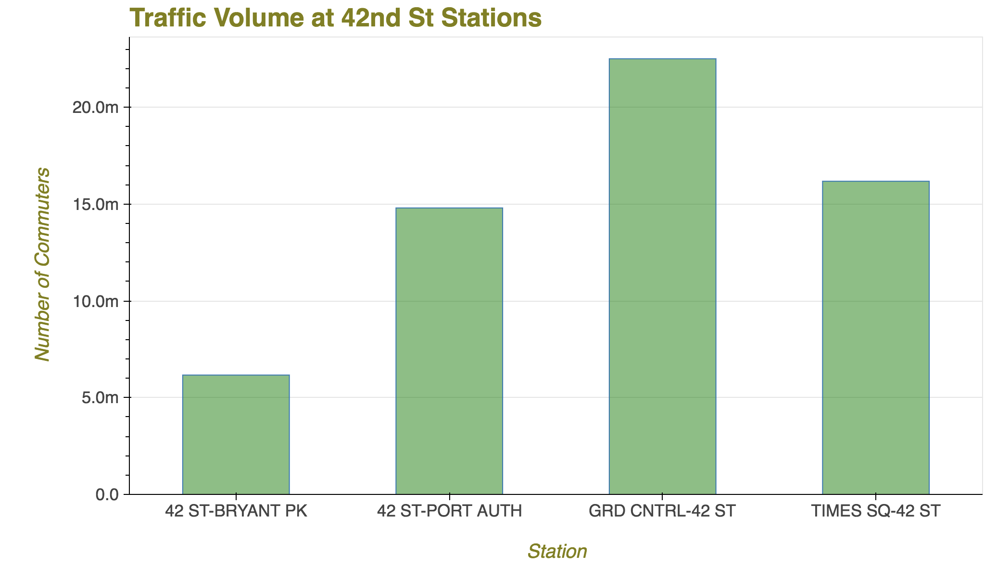
Site Selection
Notes:
Why Grand Central?
- Grand Central leads other sites by 7.5M commuters
-

Slide 10
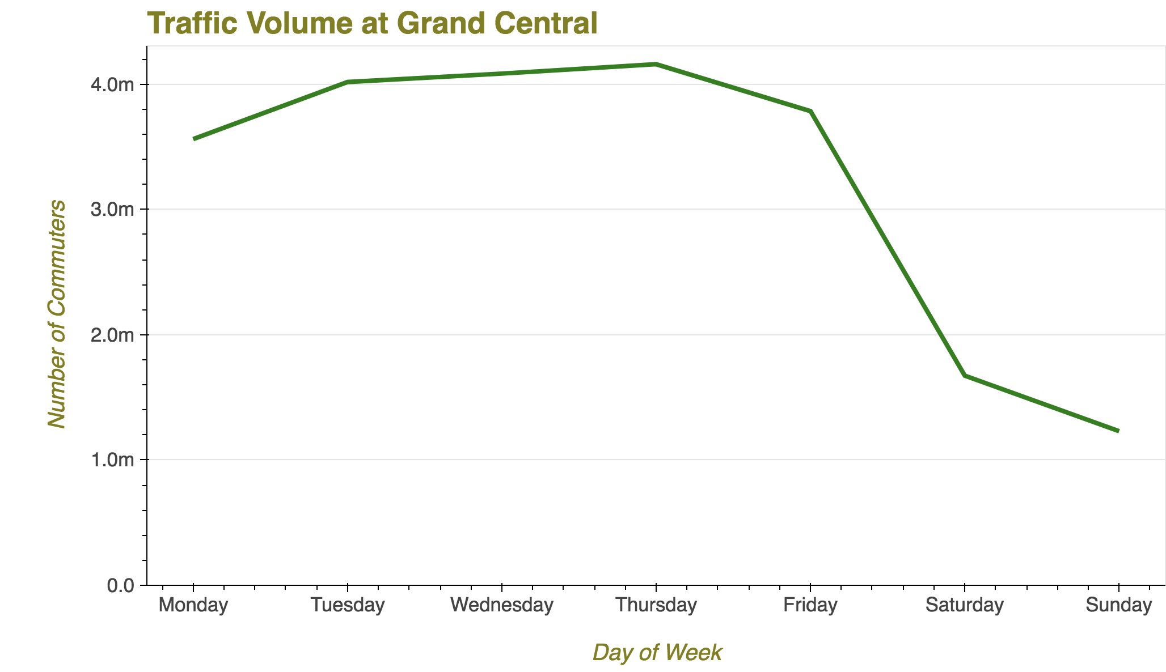
Weekly Traffic Profile
Notes:
- Traffic drops off significantly on weekends
- Traffic goes up until Thursday then declines for rest of week

Slide 11
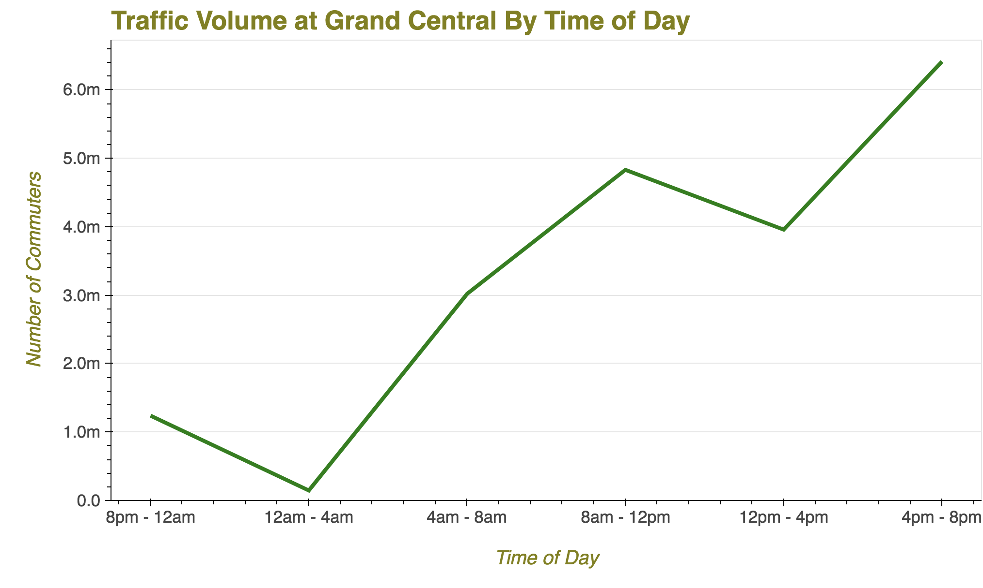
Daily Traffic Profile
Notes:
- Highest volume times are Early Morning and Evening
-

Slide 12
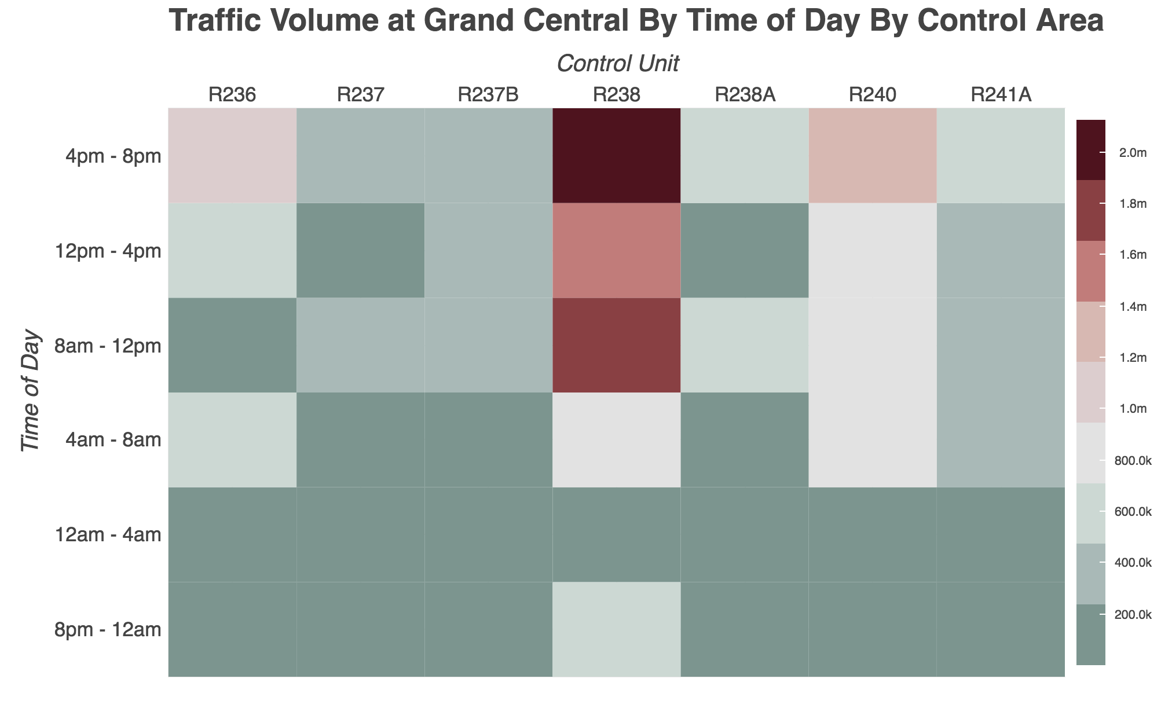
Traffic Profile by Area

Slide 13
Next Steps Current Data
Expand to other busy stations
Expand to cover the whole year
Holidays?
Station Mapping

Slide 14
Next Steps Additional Data
Police Stations
Crime statistics
Overall plan for whole city
Notes:
More data:

Slide 15

Further Suggestions

